Slide 1


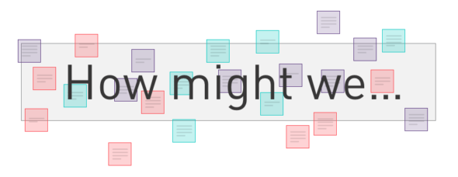

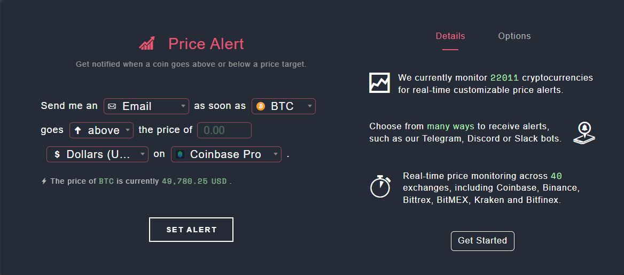
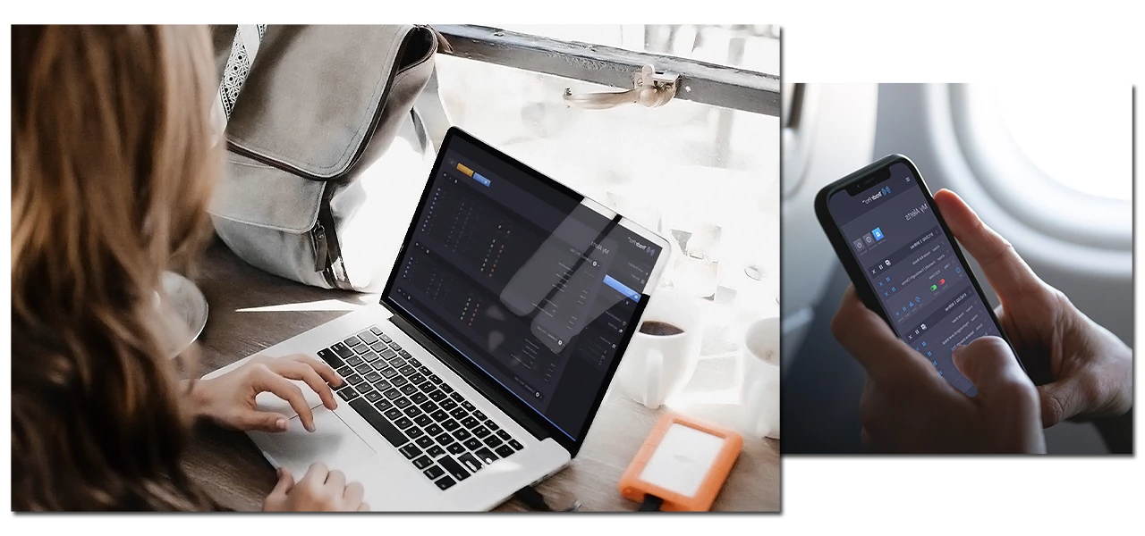
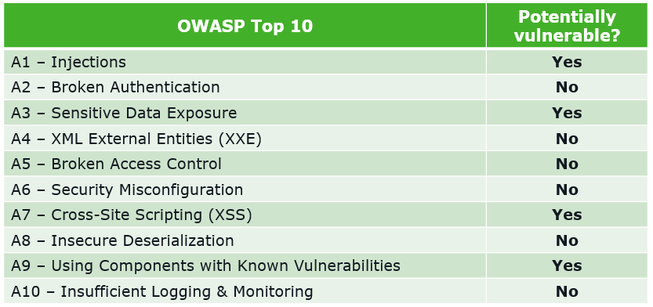

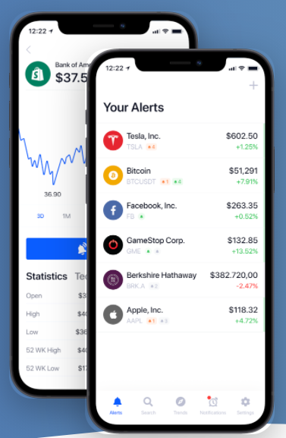
IoT individual project poster (To the moon)
Ferran Tombal
500799894
Concept
Blueprint learnings and failures
Research question
To the moon! (Crypto alert)
“Crypto alert” is an IoT device that keeps an eye of your savings in the crypto market and alerts users when big profits are made.
The embedded device has access to the internet and Its being used to obtain data about several cryptocurrencies by calling an external API via the HTTP protocol.
Crypto alert also exists out of a web application. This web application retrieves the cryptocurrency information like the current price from the embedded device using HTTP. It also has a form where users can enter the price and quantity of the cryptocurrency they’ve purchased. Furtherrmore the website also calculates the total amount of profit/loss and displays all the purchases of the logged in user on the “Purchase” page.
The embedded device retrieves the total amount of profit from the web application and it produces a sound and flashes an LED light when the user has made large gains and a different sound when users have made a certain amount of loss.
One of the most important things I’ve learned during this blueprint phase was that I got familiar with the Python programming language which I’ve never used before prior to this project. I only have prior experience with programming languages like Java, PHP and JavaScript/Typscript. I also learned some other techniques like Jinja (Used as a web template for Python) and a Python framework called “Flask”. Besides Python I also learned the basics of Arduino “Embedded system” programming and some specific things like connecting an active buzzer to a Wemos d1 Mini Pro.
Some obstacles and failures I’ve encountered:
The active buzzer I’m using has an operating voltage of 3.5-5.5 Voltage which exceeds the operating voltage of the microcontroller I’m using which is 3.3V, therefore it’d be better to use a resistor otherwise it can cause failure due to overheating.
You can not connect the Arduino Uno with a Wi-Fi connection to access the internet. the Arduino Uno does not have the ability to communicate with anything other than the computer which is programming it. When the Uno is unplugged from the computer, it can’t connect to anything at all. Therefore I had to use the Wemos D1 mini pro instead which has an ESP2866 microcontroller that can connect to a WIFi connection.
Chosen profile: Infrastructure and security
How might we question:
How might we research and improve the security and infrastructure of the product so that it meets, for example, the OWASP top 10 analysis requirements.
Link to the OWASP top 10 for IoT devices:
https://www.venafi.com/blog/top-10-vulnerabilities-make-iot-devices-insecure
Problem analysis:
Why is this a problem:
Good security is essential to protect a product from hackers and other malicious users. The OWASP Top Ten is an expert consensus of the most critical risks facing web applications and the teams who are developing them
What happens if it wouldn’t’ be solved:
Web security is important to keeping hackers and cyber-thieves from accessing sensitive information. Without a proactive security strategy, This product risks the spread and escalation of malware, attacks on other websites, networks, and other IT infrastructures.
To whom is it a problem:
To users using the product or other networks that are connected to the product (Web application or embedded device) in some way.
Scenario / Target audience
Competition analysis
What does the typical crypto ‘trader’ look like?
25-34 year olds, second highest group, 35-45
Mostly male investors (95%)
Low-tech to high-tech individuals
Global
Source: https://medium.com/@BountyBase/who-are-the-investors-behind-the-300-billion-dollar-crypto-industry-a82a701d1771
There are some competitors that kind of have the same functionalities.
These are the top 3 competitors:
Cryptocurrencyalerting (https://cryptocurrencyalerting.com/)
Keeps track of many different crypto coin prices
Has multiple functionalities like Price alert and Wallet Watch alert
Has multiple ways of alerting the user like phone calls and emails
No IoT device (Webapp only)
2. Tradr Pro (https://tradrpro.com/)
Large control panel
Mobile phone and webapp supported
Instant push notifications via Telegram
Proceedings
Since I’ve chosen for the security profile, my main focus will be on improving the security portion of the product. I am going to write a security report in which I will investigate which vulnerabilities my application have and if they relate to the OWASP top 10. I’m also going to research the specific security threads for IoT devices in general. After researching I will try to make my product more secure and test whether my interventions have worked.
A
B
The Crypto alert product is mostly appealing to people that don’t own a smartphone since smartphone users can easily download an iOS or android app to receive crypto alerts.
In the Netherlands, 99% of the population aged 18-34 owns a smartphone. That means that there’s only a very small amount of people that might be into crypto and don’t own a smartphone in the Netherlands.
Source: https://www.pewresearch.org/global/2019/02/05/in-emerging-economies-smartphone-adoption-has-grown-more-quickly-among-younger-generations/
3. Stock alarm (https://stockalarm.io/)
Also supports normal stocks instead of just cryptocurrency
Supports Android and iOS
Many trigger types including limits, percent change, price change, SMA, EMA, MACD, RSI, death cross, and gold cross. patterns.
There wasn’t much information online about these products regarding the security aspects, for example what protocols are being used and how user data is being protected.

